Slide 1

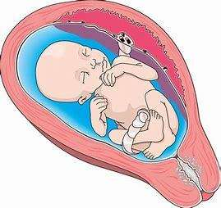
“A PORTABLE DEVICE FOR MONITORING FOETAL MOVEMENT COUNT”
Team Mentor
Team Members
DR.V.VAISHNAVI,ASP/EEE
NAZREEN BANU B
SUBHASHINI R
RAMALAKSHMI R
ABINAYA M

Slide 2



PROBLEM STATEMENT
Stillbirth is a widespread problem of the world today. It is estimated that, in high-income countries, 2.6 million babies died in uteri in 2015, with one in every 113～769 pregnancies dying in utero after 28 weeks of gestation
Early detection of potential risk factors in pregnant woman and timely intervention to reduce the likelihood of stillbirth can be achieved by establishing antenatal FM detection
There is a pressing need for an innovative and portable device that can accurately track and record fetal movement counts, providing expectant mothers and healthcare professionals with a reliable tool for continuous monitoring.

Slide 3
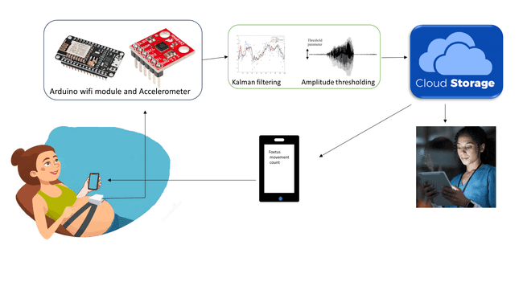
SOLUTION DESIGN
The wearable pregnant woman fetal movement detection system is designed with a robust architecture that integrates essential components to ensure accurate and reliable monitoring of fetal movements.
The wearable device includes two acceleration sensors, an Arduino ESP32, power protection module, OLED Display and other functional modules. The sensor efficiently captures fetal movement data, which is transmitted wirelessly using low-power Bluetooth communication
The seamless integration with Android smartphones enables real-time information interaction, facilitating the storage and visualization of fetal movement detection data. This approach ensures user-friendly system for expectant mothers to monitor and engage with their baby's movements effortlessly.

Slide 4
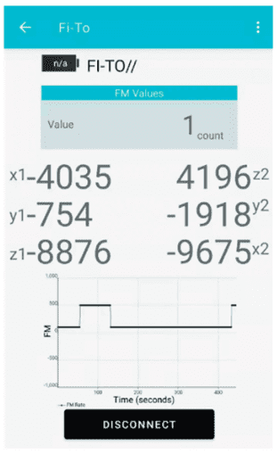
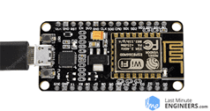
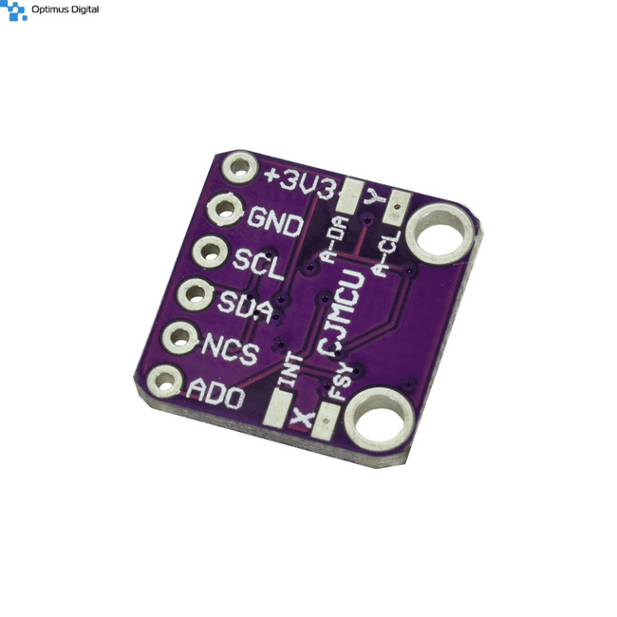



METHODOLOGY
NodeMCU
ESP-32
A
ACCELEROMETER SENSOR-1
BLUETOOTH
A
ACCELEROMETER SENSOR-2
FM COUNT
05

Slide 5

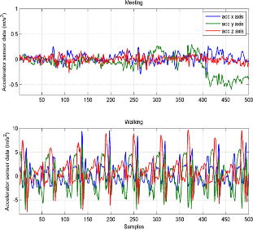

FLOW DIAGRAM
The system operates by collecting data as fetal movement signals through MPU-9250 acceleration sensor
The signal pre-processing stage employs the Kalman filtering algorithm to remove some of the interference noise introduced by large maternal movements..
Kalman filtering
Feature extraction
Signal processing
Finally, the result of the fetal movement recognition processing is saved and output to the Bluetooth data communication task
The pre-processed data is then processed by the amplitude threshold pre-recognition stage, which filters out artifact signals that are similar to the fetal movement signal.
FM :06

Slide 6
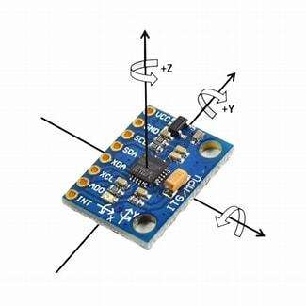
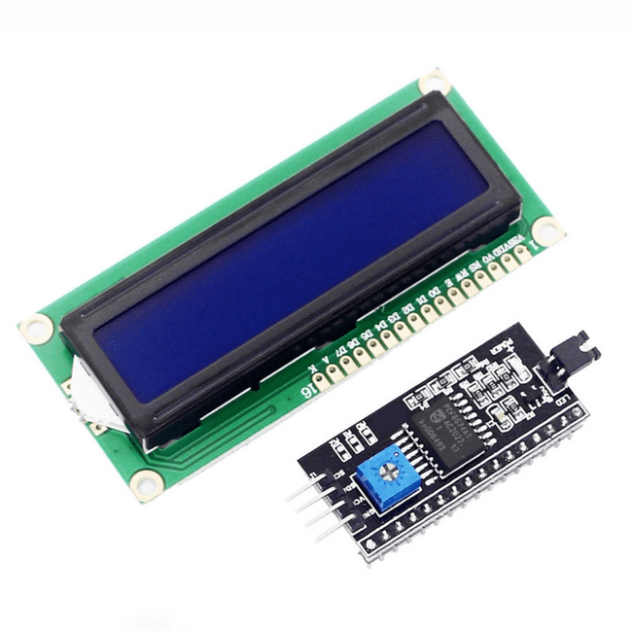
HARDWARE COMPONENTS
The NodeMCU ESP8266 serves as the central processing unit in the system. It integrates Wi-Fi capabilities, making it suitable for IoT applications. The NodeMCU communicates with sensors, processes data, and transmits information to the user interface.
The LCD with I2C module is utilized for displaying real-time data to the user. Its compatibility with the NodeMCU and the use of the I2C communication protocol simplify integration and data exchange, resulting in a streamlined user interface.
The Accelerometer sensor detects fetal movements by measuring changes in acceleration. It serves as the primary input device for monitoring fetal activity, providing crucial data for assessing fetal well-being and detecting abnormal movement patterns.

Slide 7
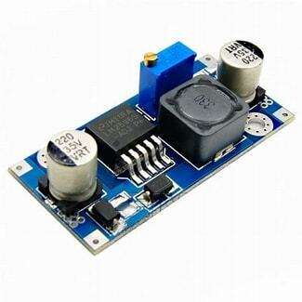
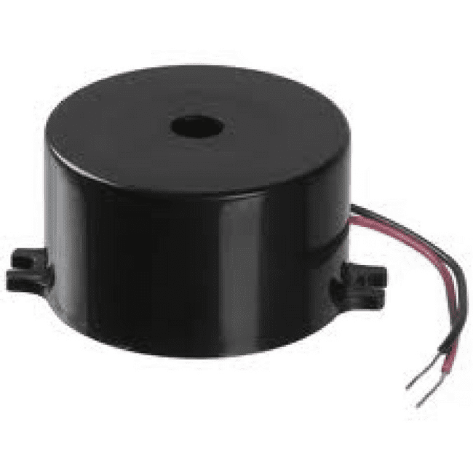
The Buck converter regulates the power supply voltage to ensure stable operation of the system components. By efficiently converting higher input voltages to lower output voltages, it minimizes power fluctuations and extends battery life, enhancing system reliability.
The Buzzer serves as an auditory feedback mechanism for alerting the user to significant events, such as abnormal fetal movements or system errors. Its role is to enhance user awareness and responsiveness, providing an additional layer of notification beyond visual displays.

Slide 8

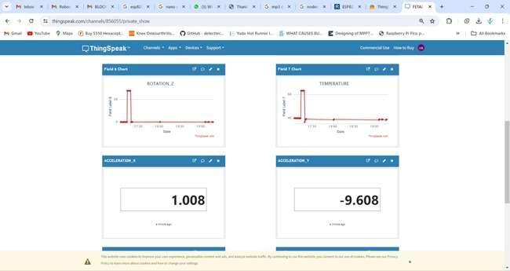
SOFTWARE USED
ARDUINO IDE
THINGSPEAK IOT CLOUD STORAGE
For storing and visualizing the collected data, the Fetal Movement Detection System utilizes ThingSpeak IoT Cloud Storage. ThingSpeak is an IoT platform that enables the collection, analysis, and visualization of sensor data in real-time.
The software development for the Fetal Movement Detection System primarily involves writing Arduino code in the Arduino Integrated Development Environment (IDE).The code defines the system's behavior, including data acquisition from sensors, processing algorithms, and control logic for user interface interactions.

Slide 9
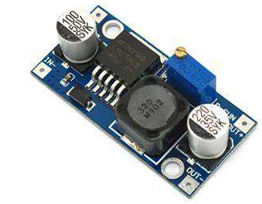
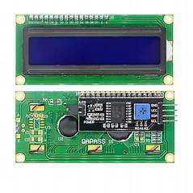
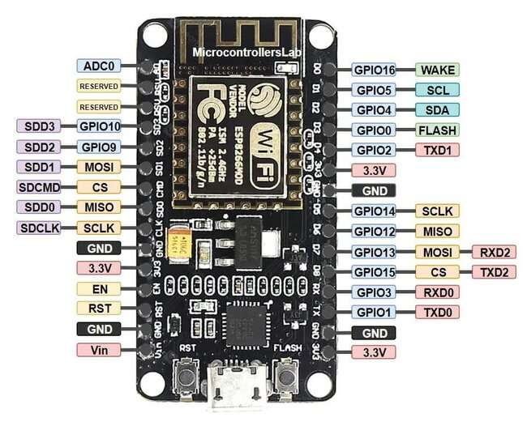
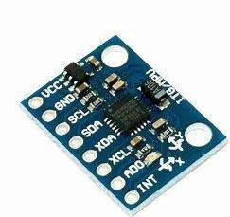
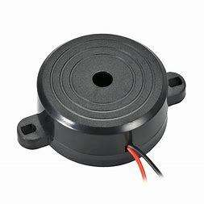
OVERALL BLOCK/CIRCUIT DIAGRAM

Slide 10
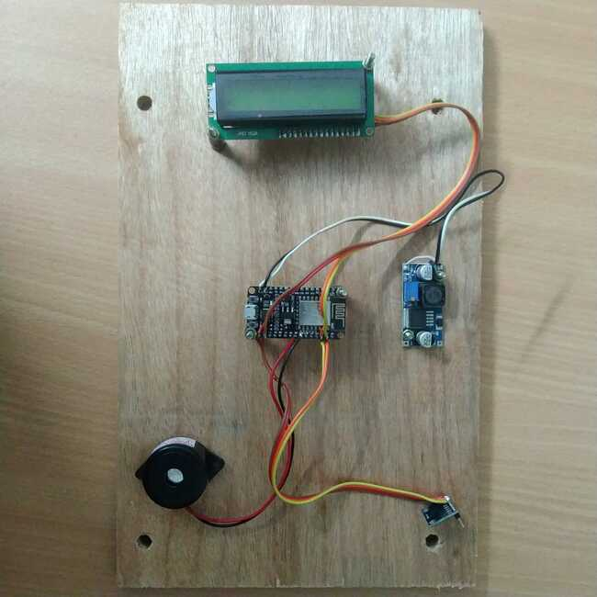
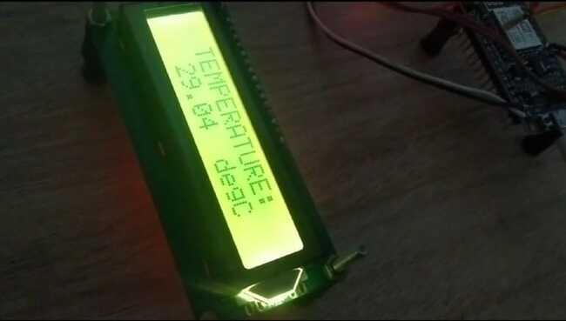
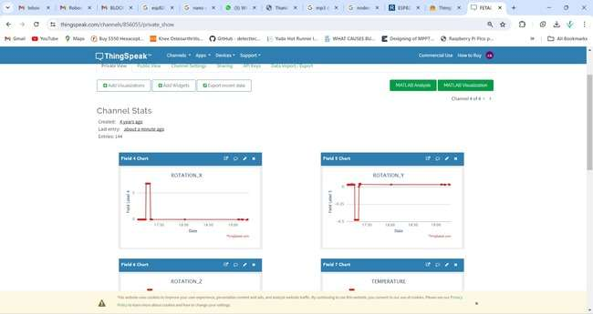
OUTPUT IMAGES / RESULTS

Slide 11
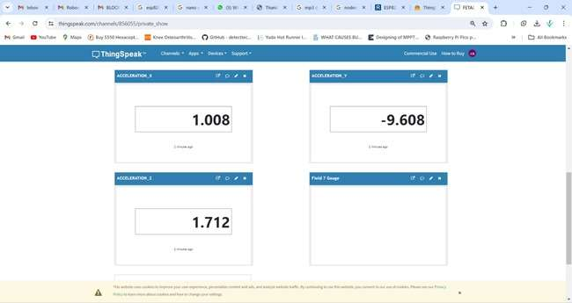
OUTPUT IMAGES / RESULTS

Slide 12

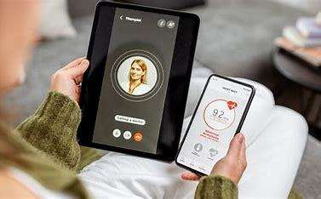
MARKET POTENTIAL
Increasing Focus on Prenatal Care:
With growing awareness about the importance of prenatal care, expectant mothers are seeking innovative solutions for monitoring fetal health. The demand for non-invasive, home-based monitoring systems is on the rise, presenting a significant market opportunity.
Telehealth and Remote Monitoring Trends:
The shift towards telehealth and remote monitoring solutions, accelerated by the COVID-19 pandemic, has created opportunities for the adoption of remote prenatal care technologies. Home-based fetal movement detection systems align with this trend, offering convenience and accessibility for expectant mothers.

Slide 13
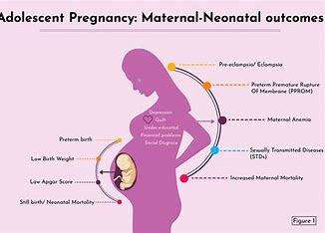

Rising Maternal Age and Pregnancy Complications:
As maternal age increases and the prevalence of pregnancy complications rises, there is a growing need for continuous fetal monitoring to detect potential risks and ensure timely interventions. This trend drives the demand for fetal monitoring systems that provide early warning signs and alerts.
Collaboration with Healthcare Providers:
Collaboration with healthcare providers, including obstetricians, gynecologists, and midwives, can facilitate the adoption of fetal movement detection systems. Integration with existing healthcare infrastructure and workflows enhances the value proposition for both providers and patients.

Slide 14
CONCLUSION
The Fetal Movement Detection System offers a breakthrough in prenatal care, providing real-time monitoring of fetal health conveniently and reliably.
Through IoT technology integration and sensor data analytics, the system addresses the evolving needs of pregnant women and healthcare providers.
Home-based monitoring enhances maternal reassurance, aids in early detection of abnormalities, and facilitates timely interventions, improving maternal and fetal health outcomes.
Accessibility, affordability, and compatibility with telehealth trends position the system as a leader in remote prenatal care solutions.
The Fetal Movement Detection System holds immense potential to shape the future of prenatal monitoring and make a lasting impact on maternal and fetal health worldwide.

Slide 15
THANK YOU!

